Slide 1
Simple Profit Maximization
Profit = Revenue – Cost
π = Q P − C (Q)

Slide 2
Simple Profit Maximization
Profit = Revenue – Cost
π = Q P − C (Q)
Suppose the cost of producing one unit of output is c, then profit is QP-cQ.

Slide 3
Simple Profit Maximization
Profit = Revenue – Cost
π = Q P − C (Q)
Suppose the cost of producing one unit of output is c, then profit is QP-cQ.
Question: What is the effect on profit of raising price by a small amount ΔP?

Slide 4
The initial position
Price
P
Cost per Unit
c
c
Q
Quantity

Slide 5
The new price
Price
P+ΔP
P
Cost per Unit
c
c
Q
Quantity
Q+ΔQ

Slide 6
The costs and benefits
Price
P+ΔP
P
Cost per Unit
c
c
Q
Quantity
Q+ΔQ

Slide 7
The costs and benefits
Price
Profit Gained =ΔPQ
P+ΔP
P
Cost per Unit
c
c
Q
Quantity
Q+ΔQ

Slide 8
The costs and benefits
Price
Profit Gained =ΔPQ
Profit Lost =−ΔQ(P-c)
P+ΔP
P
Cost per Unit
c
c
Q
Quantity
Q+ΔQ

Slide 9
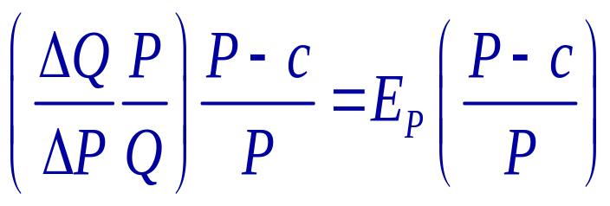
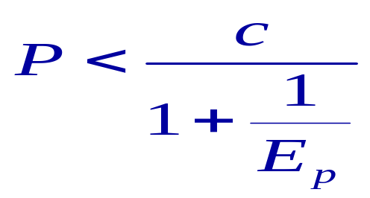
A small price increase leads to profit going up if
profit gained > profit lost
ΔP Q > −ΔQ (P-c)
-1 <
or if

Slide 10
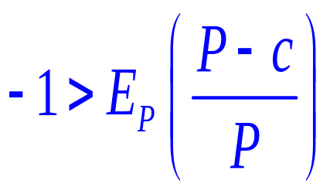
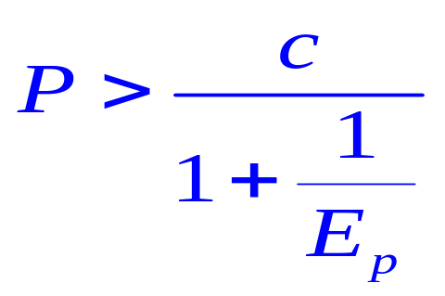
A small price increase leads to profit going down if profit gained < profit lost

Slide 11
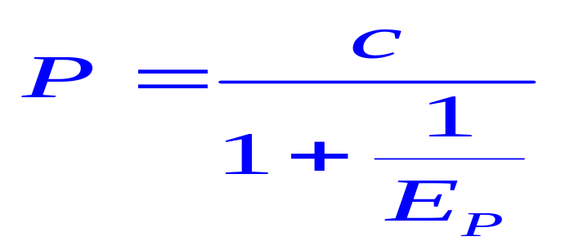
At the profit-maximizing price

Slide 12
At the profit-maximizing price
Again the elasticity you use is vital. See the discussion in the previous section!
E<-1 at optimum so firm must price on elastic part of demand curve.

Slide 13
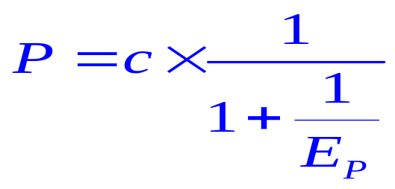
Mark-up Pricing
A little re-arrangement of the formula above gives the mark-up formula
Price is a constant mark-up over cost per unit – this is the most commonly used pricing formula.
(Note: It must be the case that demand is elastic as otherwise firm could always increase profit by raising prices.)

Slide 14
A General Method
Profit = Revenue –Cost
It is a good idea to increase output as long this increasing profit.

Slide 15
A General Method
Profit = Revenue –Cost
It is a good idea to increase output as long this increasing profit.
An increase in output has 2 effects: increasing revenue and increasing cost.
Δπ = ΔR – ΔC

Slide 16
A General Method
Profit = Revenue –Cost
It is a good idea to increase output as long this increasing profit.
An increase in output has 2 effects: increasing revenue and increasing cost.
Δπ = ΔR – ΔC
ΔR is called Marginal Revenue (MR)
ΔC is called Marginal Cost (MC)

Slide 17
Maximizing Profit
MR>MC the firm should increase output because profit is rising faster than cost

Slide 18
Maximizing Profit
MR>MC the firm should increase output because profit is rising faster than cost
MR<MC the firm should reduce output because cost is rising faster than profit

Slide 19
Maximizing Profit
MR>MC the firm should increase output because profit is rising faster than cost
MR<MC the firm should reduce output because cost is rising faster than profit
MR=MC optimal

Slide 20
An Example
A firm has the demand Q = 8.5-0.05P

Slide 21
An Example
A firm has the demand Q = 8.5-0.05P
Hence its prices are P=170-20Q

Slide 22
An Example
A firm has the demand Q = 8.5-0.05P
Hence its prices are P=170-20Q
Thus its revenue is PQ =170Q-20Q²

Slide 23
An Example
A firm has the demand Q = 8.5-0.05P
Hence its prices are P=170-20Q
Thus its revenue is PQ =170Q-20Q²

Slide 24
An Example
A firm has the demand Q = 8.5-0.05P
Hence its prices are P=170-20Q
Thus its revenue is PQ =170Q-20Q²
The firm has the costs C(Q) = 100 + 38Q
  100 Fixed Costs
  38 Variable Cost

Slide 25
An Example
A firm has the demand Q = 8.5-0.05P
Hence its prices are P=170-20Q
Thus its revenue is PQ =170Q-20Q²
The firm has the costs C(Q) = 100 + 38Q
  100 Fixed Costs
  38 Variable Cost
Profit = PQ –C(Q)
= 170Q-20Q² − [100 +38Q]

Slide 26
Revenue = 170Q-20Q²
Cost = 100+38Q
Q=4.25

Slide 27
Revenue = 170Q-20Q²
Profit
Cost = 100+38Q
Q=4.25

Slide 28
Maximum Profit = 170(3.3)-20(3.3)²-100-38(3.3) = 63.8
Revenue = 170Q-20Q²
Profit
Cost = 100+38Q
Q=3.3
Q=4.25

Slide 29
Notes
At low quantities revenues rise faster than cost

Slide 30
Notes
At low quantities revenues rise faster than cost
At high quantities costs rise faster than revenue

Slide 31
Notes
At low quantities revenues rise faster than cost
At high quantities costs rise faster than revenue
Revenues and costs have the same slope at the max

Slide 32
Notes
At low quantities revenues rise faster than cost
At high quantities costs rise faster than revenue
Revenues and costs have the same slope at the max
IF YOU ARE MAXIMIZING REVENUE YOU ARE PRODUCING TOO MUCH!
RAISE YOUR PRICE!

Slide 33
MR
Slope of the revenue function
= The revenue obtained from selling an extra unit
= Marginal Revenue or MR.
Revenue = 170Q – 20Q²
MR =dR/dQ = 170 – 40 Q

Slide 34
MC
Slope of the cost function
= The cost of producing an extra unit
= Marginal Cost or MC.
Cost = 100 + 38 Q
MC = dC/dQ = 38

Slide 35
We can draw the profit maximization picture in terms of the slopes.
MR = 170-40Q
MC = 38
Q=3.3

Slide 36
What if there is an increase in the fixed costs from 100 to 120?
MC and MR don’t change.

Slide 37
What if there is an increase in the fixed costs from 100 to 120?
MC and MR don’t change.
Thus the optimal level of output doesn’t change

Slide 38
What if there is an increase in the fixed costs from 100 to 120?
MC and MR don’t change.
Thus the optimal level of output doesn’t change
BUT maximized profit goes down by 20

Slide 39
What if unit cost increases from 38 to 40?
MR = 170-40Q
MC = 38
Q=3.3

Slide 40
Should produce less as MC increases
MR = 170-40Q
MC=40
MC = 38
Q=3.3

Slide 41
What if Demand increases to 180-40Q?
MR = 170-40Q
MC = 38
Q=3.3

Slide 42
Should produce more as MR increases to 180-40Q
MR = 180-40Q
MR=170-40Q
MC = 38
Q=3.3

Slide 43
What happens to prices here?
You may be selling more at a lower price or at a higher price this is not clear yet.
It depends on the formula

Slide 44
Maximizing Profit vs. Maximizing Revenue
Burger King & Franchisees:
A Burger King Franchise has the following contract with BK:
Franchisee gives 7.5%-16% of revenues to BK and keeps what’s left.

Slide 45
Maximizing Profit vs. Maximizing Revenue
Burger King & Franchisees:
A Burger King Franchise has the following contract with BK:
Franchisee gives 7.5%-16% of revenues to BK and keeps what’s left.
The franchisee wants to maximize profit.
Franchisee wants prices so that (100-7.5)%MR=MC, this shifts the MR curve down so lower output at higher price.
BK wants to maximize revenue.( Why? )
MR=0.

Slide 46
How does this affect pricing?
Who wants high prices?
Who wants low prices?
Questions: Are there contracts that don't lead to this conflict on pricing?

Slide 47
Prices are Controlled by Many People
Often the price paid by the customer is a sum of a wholesale price and a retail mark-up.
P = P₁ + P₂
P₁ = Wholesale Price
P₂ = Retail Mark-up
ASSUME ALL COSTS ARE FIXED – SO FIRMS ONLY CARE ABOUT MAXIMIZING REVENUE.

Slide 48
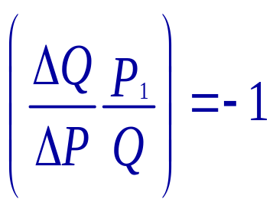
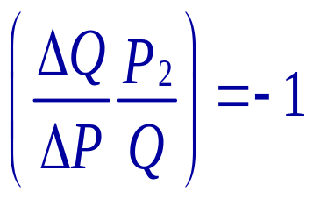
TO MAXIMIZE REVENUE ELASTICITY = -1
Wholesaler sets price to maximize his revenue
Retailer sets price to maximize his revenue

Slide 49
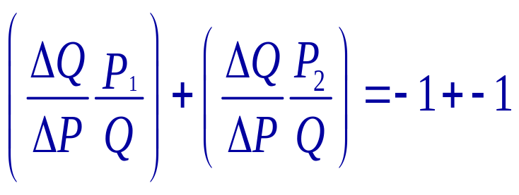
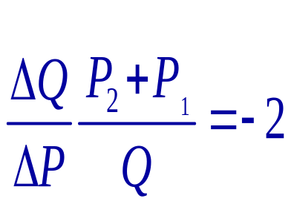
The combined effect of this is
Prices are much too high as the consumers’ price has an elasticity of -2.

Slide 50
Case: Revenue Sharing in the Video-Rental Industry
Set-Up
Video Rental is 55% of studios' revenue in 1999. (22% theatres, 23% TV rights etc)
Before 1998 all video stores obtained tapes form distributors on fixed fee basis. (around $70 a tape).
The problem – video rental is over-priced and neither distributors nor rental stores are maximizing their profit.

Slide 51
Two simplifying assumptions:
(1) Most of the stores costs are fixed – apart from the cost of buying tapes.
(2) The studio's marginal costs per pre-recorded tape are very small let us call it c. (c ≈ 0).

Slide 52
This creates a problem
Stores buy too few tapes because they have a high MC =$70.
The studio has a very low cost of producing tapes and would like the stores to buy many more.
The total profit of the studio + store is maximized at MR = c.

Slide 53
Store Cost = FQ
Revenue
Studio's Cost = cQ
Number of Tapes

Slide 54
What Stores Actually Do
Store Cost = FQ
Revenue
Studio's Cost = cQ
Number of Tapes
Max
Profit for
store

Slide 55
This gives studios the profit
Store Cost = FQ
Revenue
Studio's Cost = cQ
Number of Tapes
Max
Profit for
store

Slide 56
But if we wanted to maximize Store + Studio Profit
Store Cost = FQ
Revenue
Studio's Cost = cQ
Number of Tapes
Max
Profit for
store
Max of store profit + studio profit.

Slide 57
This is called the "double marginalization" problem
It has two solutions:
(1) The studio forces the retailer to set a particular price. The problem with this is … it is illegal.
(Resale price maintenance.)
(2) A "two part tariff". There is a fixed cost of buying the tape and the store and studio then share part of the revenue.

Slide 58
In 1998 there was a new chairmen of Blockbuster, he pushed for the new form of contract.
A fixed fee ($0 -$8 per unit)
And a share of rental revenue (between 40% and 60%)
The large chains (Blockbuster) negotiate over this.
Small stores sign up to Rentrak for the revenue monitoring technology and participate in the share rate negotiated by them.

Slide 59
10,000 firms have the capability to participate in revenue-sharing contracts.
10,000 do not have the technology to do this.
The really surprising thing is that it took the customers to propose this not the studios!
Results 8% increase in total profit.

